Slide 1
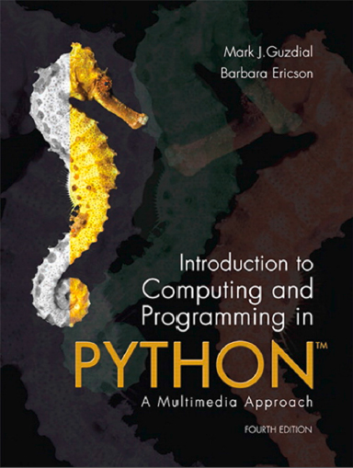
Introduction to Computing and Programming in Python™: A Multimedia Approach
Fourth Edition
Chapter 9
Making Sounds by Combining Pieces
Copyright © 2016, 2013, 2010 Pearson Education, Inc. All Rights Reserved
Notes:
If this PowerPoint presentation contains mathematical equations, you may need to check that your computer has the following installed:
1) MathType Plugin
2) Math Player (free versions available)
3) NVDA Reader (free versions available)
With thanks to John Sanders of Suffolk University for contributions to these slides!

Slide 2
Learning Objectives (1 of 2)
9.1 To blend sounds so that one fades into another.
9.2 To create echoes.
9.3 To change the frequency (pitch) of a sound.
9.4 To create sounds that don’t exist in nature by composing more basic sounds (sine waves).
9.5 To choose between sound formats such as M I D I and M P 3 for different purposes.

Slide 3
Learning Objectives (2 of 2)
9.6 To use ﬁle paths to reference ﬁles at different places on the disk.
9.7 To explain blending as an algorithm that crosses media boundaries.
9.8 To build programs from multiple functions.

Slide 4

Making More Complex Sounds
We know that natural sounds are often the combination of multiple sounds.
Adding waves in physics or math is hard.
In computer science, it’s easy! Simply add the samples at the same index in the two waves:

Slide 5
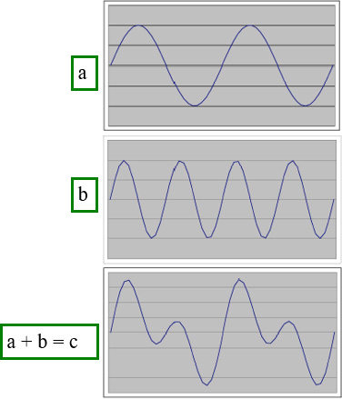
Adding Sounds
The first two are sine waves generated in Excel.
The third is just the sum of the first two columns.

Slide 6
Uses for Adding Sounds
We can mix sounds
We even know how to change the volumes of the two sounds, even over time (e.g., fading in or fading out)
We can create echoes
We can add sine (or other) waves together to create kinds of instruments/sounds that do not physically exist, but which sound interesting and complex

Slide 7
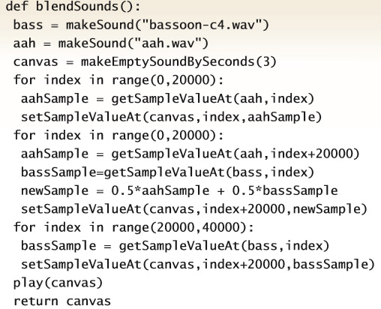
Blending Two Sounds

Slide 8
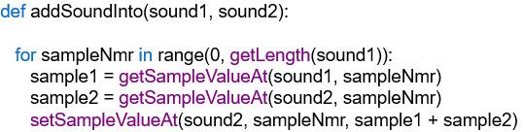
A Function for Adding Two Sounds
Notice that this adds sound1 and sound2 by adding sound1 into sound2

Slide 9
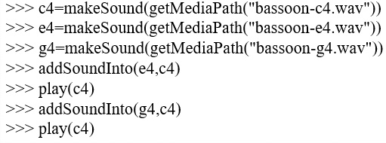
Making a Chord by Mixing Three Notes
Notes:
Really do this – it's fun!
Really do this – it's fun!

Slide 10
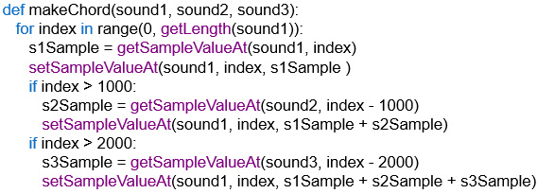
Adding Sounds with a Delay
Add in sound2 after 1000 samples
Add in sound3 after 2000 samples
Note that in this version we’re adding into sound1!
Notes:
Play with the delay here.
Play with the delay here.

Slide 11
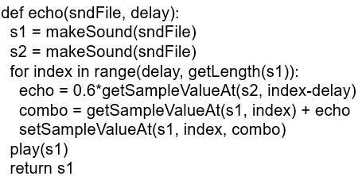
Creating an Echo
This creates a delayed echo sound, multiplies it by 0.6 to make it fainter and then adds it into the original sound.

Slide 12
Clicker: What is Sndfile in the Echo Function?
Path to a sound file.
A sound that we’re going to make echoes from.
A base filename (like “aah.wav”) that we’re going to use with getMediaPath()

Slide 13
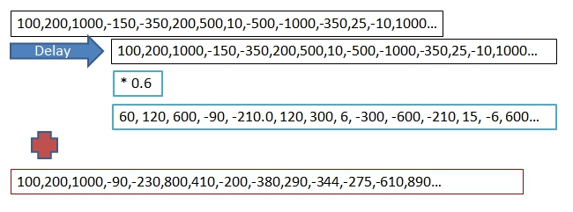
How the Echo Works
Top row is the samples of our sound. We’re adding it to us, but delayed a few samples down, and multiplied to make it softer.

Slide 14
Clicker: Could you Go Past the End of the Sound?
If you’re adding two sounds together, one offset by a “delay,” couldn’t you go past the end?
Absolutely – you only want to do this with short sounds.
No, we’re only going to the end of the sound with the FOR loop.
Yes, so we make the target sound extra big to make space.

Slide 15
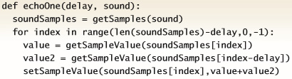
Echo with a Single Sound

Slide 16
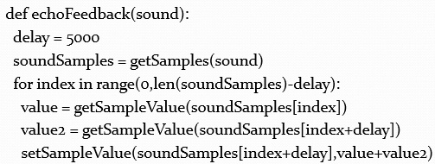
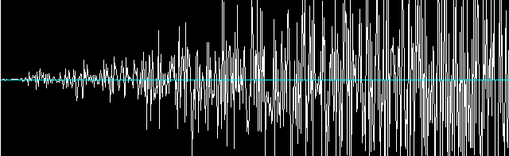
Echo with Feedback

Slide 17
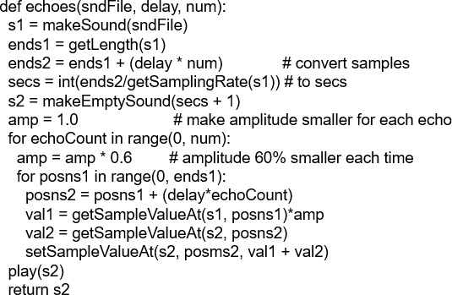
Creating Multiple Echoes

Slide 18
How Sampling Keyboards Work
They have a huge memory with recordings of lots of different instruments played at different notes
When you press a key on the keyboard, the recording closest to the note you just pressed is selected, and then the recording is shifted to exactly the note you requested.
The shifting is a generalization of the half/double functions we saw earlier.

Slide 19
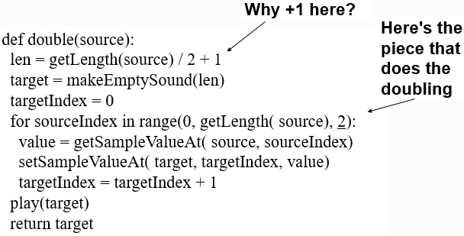
Doubling the Frequency

Slide 20
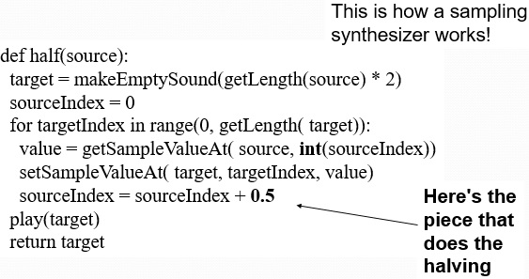
Halving the Frequency

Slide 21
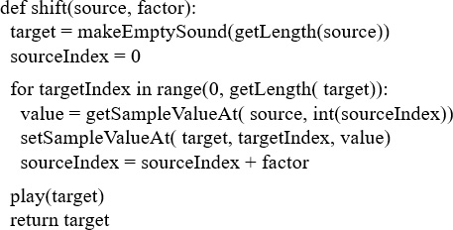
Can We Generalize Shifting a Sound into Other Frequencies?
This way does Not work:

Slide 22
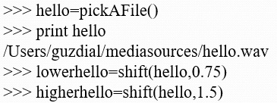
Watching it not Work
It’ll work for shifting down, but not shifting up. Why?
I wasn’t able to do what you wanted.
The error java.lang.ArrayIndexOutOfBoundsException has occured
Please check line 7 of /Users/guzdial/shift-broken.py

Slide 23
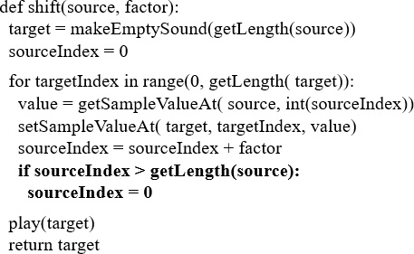
We Need to Prevent Going Past the End of the Sound

Slide 24
Now We have the Basics of a Sampling Synthesizer
For a desired frequency f we want a sampling interval like this:

Slide 25
How the Original Sound Synthesizers Worked
What if we added pure sine waves?
We can generate a sound that is just a single tone (see the book)
We can then add them together (perhaps manipulating their volume) to create sounds that don’t exist in nature
Don’t have to use just sine waves
Waves that are square or triangular (seriously!) can be heard and have interesting dynamics
We can add together waves of lots of types to create unique sounds that can’t be created by physical instruments
We call this additive synthesis
Additive synthesis as-is isn’t used much anymore

Slide 26
Sampling as an Algorithm
Think about the similarities between:
Halving the sound’s frequency and scaling a picture larger.
Doubling the sound’s frequency and scaling a picture smaller.

Slide 27
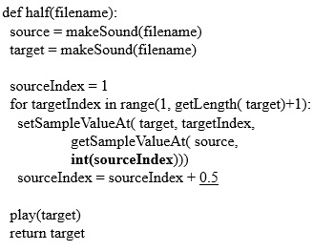
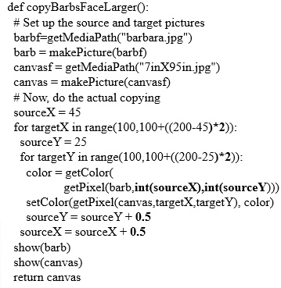
Recall These Two Functions

Slide 28
Our Programs (Functions) Implement Algorithms
Algorithms are descriptions of behavior for solving a problem.
A program (our Python functions) is an executable interpretations of algorithms.
The same algorithm can be implemented in many different languages.
The same algorithm can be applied to many different data sets with similar results.

Slide 29
Both of These Functions Implement a Sampling Algorithm
Both of them do very similar things:
Get an index to a source
Get an index to a target
For all the elements that we want to process:
Copy an element from the source at the integer value of the source index to the target at the target index
Increment the source index by
Return the target when completed
This is a description of the algorithm.

Slide 30
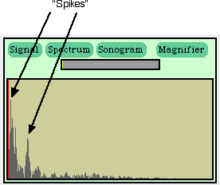
Adding Sine Waves to Make Something Completely New
We saw earlier that complex sounds (like the sound of your voice or a trumpet) can be seen as being a sum of sine waves.
We can create complex sounds by summing sine waves.
These are sounds made by mathematics, by invention, not based on anything in nature.

Slide 31
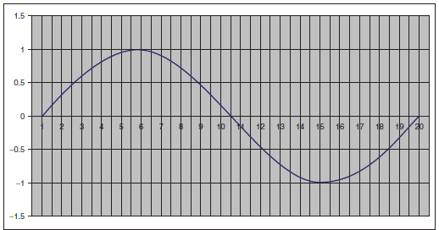
Basic Idea: Build a Sine Wave
If we want a 440 Hertz sound wave, then we need one of these cycles every
of a second.
We need to break this wave into the number of pieces in our sampling rate.

Slide 32
Our Algorithm
At each entry of the sound sampleIndex, we want to:
Get the fraction of sampleIndex/samplesPerCycle.
Multiply that fraction by
That’s the number of radians we need.Take the sine of
Multiply the result by the desired amplitude and put it in the sampleIndex.

Slide 33
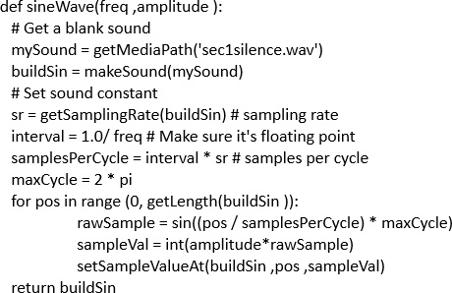
Our Code

Slide 34
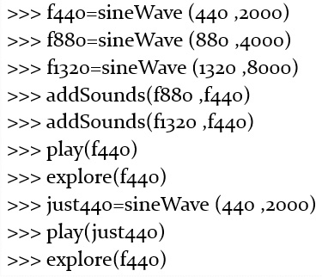
Adding Pure Sine Waves Together
Adding together 440Hertz, 880Hertz, and 1320Hertz, with increasing amplitudes.
Comparing to a 440Hertz wave

Slide 35
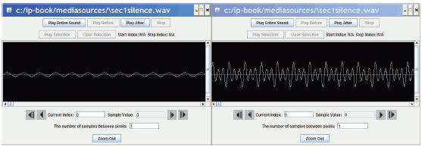
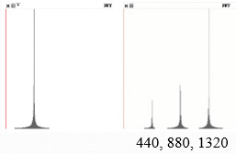
Comparing the Waves
Left, 440 Hertz; Right, combined wave.
In Explorer
In the Spectrum view in MediaTools

Slide 36
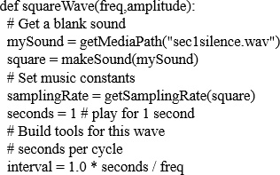
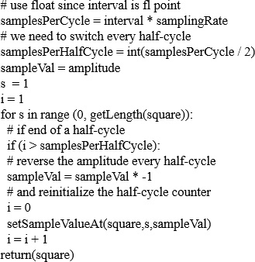
Making More Complicated Waves
Using square waves, instead of sine waves, can be a richer sound

Slide 37
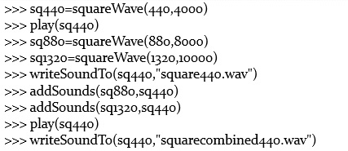
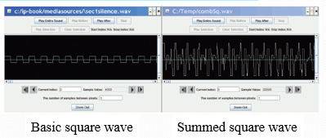
Building Sounds with Square Waves

Slide 38
Sound Synthesis Techniques
Adding sine and square (and triangle) waves is additive sound synthesis.
Most common modern synthesis technique is frequency modulation (F M) synthesis.
Much richer sound.
Just about any way you can imagine to fill a sound mathematically can lead to an interesting synthesis technique.
Create random noise, then filter parts out: Subtractive synthesis

Slide 39
Adding Envelopes
Most real synthesizers today also allow you to manipulate envelopes
An envelope is a definition of how quickly the aspects of the sound change over time
For example, the rise in volume (attack), how the volume is sustained over time (sustain), how quickly the sound decays (decay): The A S D envelope
Pianos tend to attack quickly, then decay quickly (without pedals)
Flutes tend to attack slowly and sustain as long as you want.

Slide 40
Why Write Sound Programs?
“Aren’t there audio tools that can do many of these things?”
Sure, and that’s good enough…if that’s good enough.
If you just want to use a sound, then simply using tools to generate the noise/instrument/sound you want is fine.

Slide 41
Communicating Process
What if you want to tell someone else how you got that sound, so that they can replicate the process, or even modify the sound in some way, or make it better?
You could write down all the steps in a sound application tool.
Tedious, error prone.
Or you could provide a program.
A succinct, executable definition of a process.

Slide 42
What is M p 3?
M P 3 files are files encoded according to the M P E G - 3 standard.
They are audio files, but they are compressed in special ways.
They use a model of how we hear to get rid of some of the sound.
If there is a soft sound at the same time as a loud sound, don’t record the soft sound
They use various compression techniques to make the sound smaller.
W A V files are compressed, but not as much, and don’t use any smart models to make themselves smaller.

Slide 43
What is M I D I?
M I D I is a standard for encoding music, not sound.
M I D I literally encodes “For this instrument (track), turn key #42 on” then later “For this instrument (track), turn key #31 off.”
The quality of the actual sound depends entirely on the synthesizer—the quality of the instrument generation (whether recorded or synthesized).
M I D I files tend to be very, very small.
Each M I D I instruction (“Play key #42 track 7”) is only about five bytes long.
Not thousands of bytes long.

Slide 44
Playing M I D I in J E S
The function playNote allows you to play M I D I piano with J E S.
playNote takes three inputs:
A note number
Not a frequency—it’s literally the piano key number
C in the first octave is 1,
is 2, C in the fourth octave is 60, D in the fourth octave is 62.
A duration in milliseconds
An intensity (0-127)
Literally, how hard the key is pressed

Slide 45
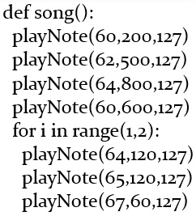
M I D I Example
Notes:
Try playing with the parameters here – more repetition, longer notes, different notes
Try playing with the parameters here – more repetition, longer notes, different notes

Slide 46

Copyright

